Slide 1
BJC HealthCare Campus Renewal Project
Nancy W. Gemeinhart, BSN, MHA, RN, CIC, FAPIC
St. Louis Council of Construction Consumers
February 8, 2018
LiUNA Event Center, St. Louis, MO

Slide 2
Background
BJC HealthCare launched a major construction project beginning 2014
2 – 12 story towers
780,000 square feet
Project management – Jacobs
Construction – ACW Alliance
Alberici
Clayco
SM Wilson

Slide 3
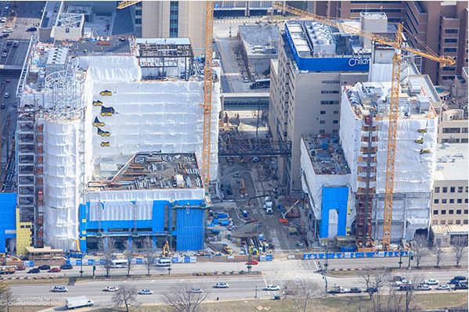
Background
Phase one project expectations:
Last 5 years
6,300 workers through the program to date
Owner Controlled Insurance Plan (OCIP)

Slide 4
Elements of OCIP Management
Safety training
Pre-access/pre-assignment screening
On-site occupational health nurse
RN case management by OH nurses
Preferred providers
Monthly meetings
Safety
Injury/case review

Slide 5
Program Development
Conducted a cost-benefit analysis
Cost of testing
Cost of time of workers
Length of time for testing
Compare onsite to off-site
Partnership between BJC, Jacobs and ACW Alliance
Bi-weekly planning meetings:
Screening criteria
All steps of the process
Developed forms for use
Established communication process between BarnesCare team and ACW

Slide 6
Program Development
Assumptions for the process:
Time for screening, some may take longer
Certain paperwork required
Some will not pass
Number of staff and number of restrooms dictates number of tests per hour
Computer modeling of process

Slide 7
Program Development
Time for screening:
Drug screen – 20 minutes
Breath alcohol screening – 10 minutes
Essential function screening – 20-30 minutes
Tested process by conducting a live person drill
Learning from the drill reviewed and modified process

Slide 8
Safety Training
Safety training completed prior to entry to construction site for all new workers
Conducted daily at BarnesCare, 5000 Manchester, St. Louis
Pre-access/pre-assignment screening for substance abuse and baseline physical screening and functional testing

Slide 9
Pre-access/Pre-assignment Screening Program
Utilized written protocols
Testing prior to initial assignment
Elements of testing:
Substance abuse
Urine drug screen
Breath alcohol testing
Baseline physical screening and functional test
Conducted by physical therapists
Videotaped

Slide 10
Substance Abuse Testing - Alcohol
Testing done to determine a subject’s breath alcohol content
Utilized an evidential breath testing (EBT) device, which conforms to National Highway Traffic Safety Administration (NHTSA) and Department of Transportation (DOT) regulations

Slide 11
Substance Abuse Testing - Drugs
10 panel rapid urine drug screen
THC, cocaine, amphetamine, methamphetamine, PCP, opiates, oxycodone, methadone, barbiturates and benzodiazepines
Standard protocols: adulteration, temperature range, refusal to cooperate, unable to provide specimen
All non-negatives sent for confirmation testing to a SAMHSA-certified lab
Utilized a licensed medical review officer (MRO)

Slide 12
Pre-Placement Physical Assessment
Purpose:
Screening to determine baseline physical status prior to performing jobs at risk of injury, strain/sprain, or repetitive motion
Background:
2013 – OSHA estimates that average costs of one MSD-related claim is $3,080 (include lost production, admin costs and other indirect costs brings average to $22,546 per claim)
Work comp fraud range 2-25% of claims filed with many involving pre-existing conditions

Slide 13
Pre-Placement Physical Assessment
Process:
Screening established by a physical therapist
Videotaped for later comparison
Not utilized to screen persons out
Benefits:
Baseline assessment of their physical abilities
If they do sustain a work-related injury, this is the baseline physical ability to which they will be rehabilitated
Detect unreported pre-existing condition
Reductions in work comp claims/costs

Slide 14
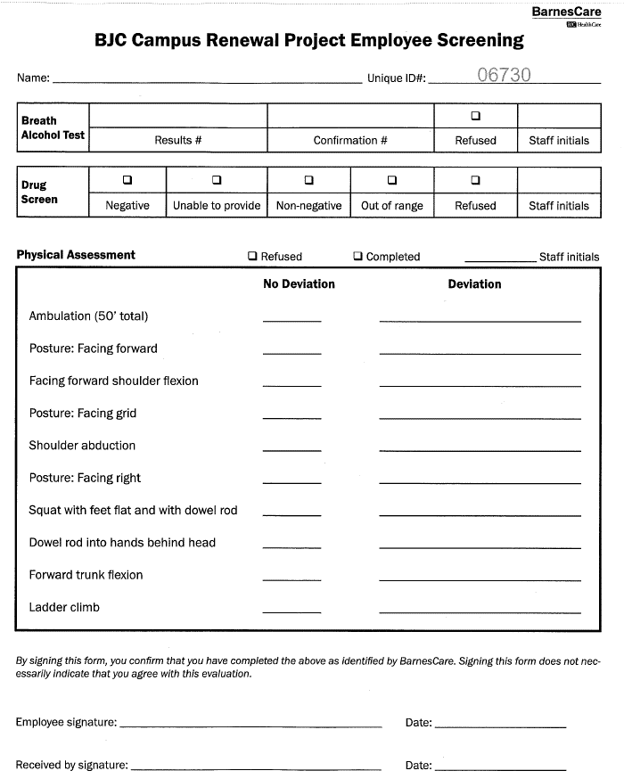

Slide 15
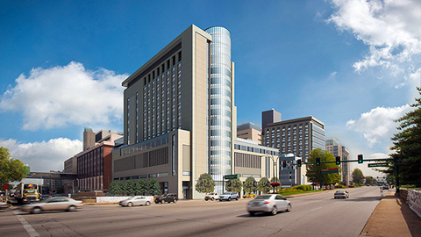
Program Benefits
Strong safety program
Significant cost avoidance

