Slide 1
Welcome!

Slide 2
Leading From The Middle

Slide 3
What Is Leadership?
Influence Nothing More Nothing Less
-John C. Maxwell

Slide 4
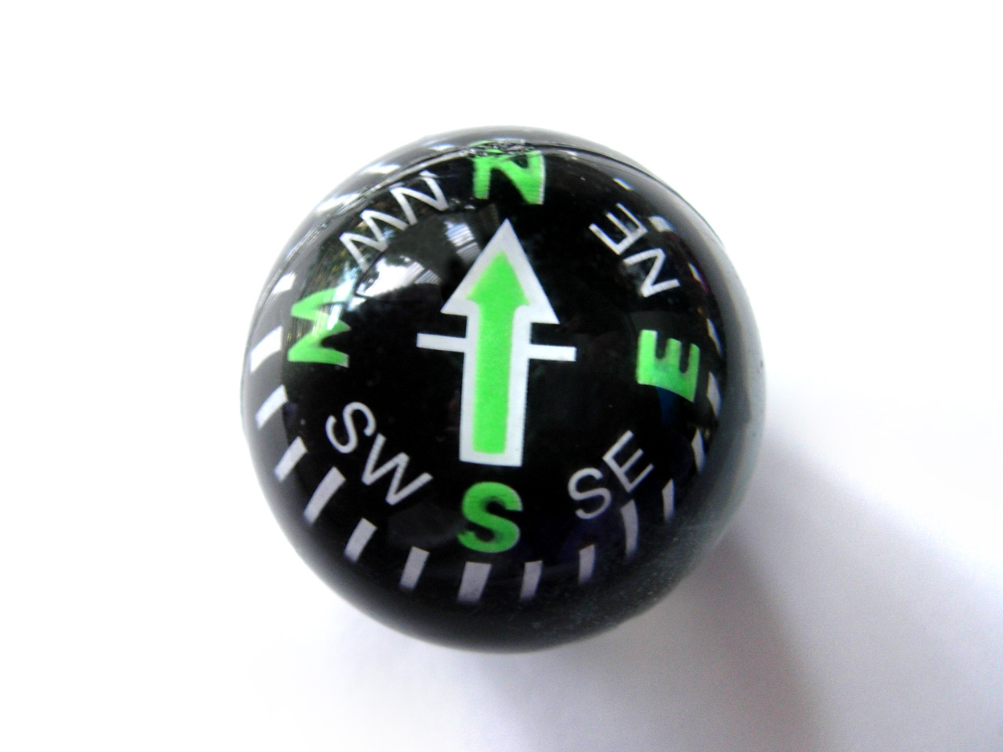
Leadership Compass

Slide 6
Take time to reflect.

Slide 7
Get a mentor or coach.

Slide 8
Principle To Lead Up
Lift Your Leaders Load

Slide 9
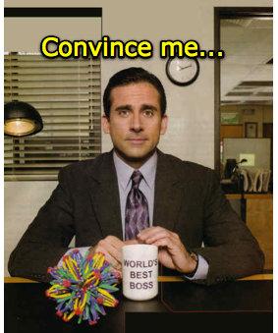

Slide 10
Lifting Gets You Noticed!

Slide 11
How To Lift Your Leaders Load

Slide 12
Do Your Own Job Well First.

Slide 13
Ask The Phrase That Pays

Slide 14
Principle To Lead Across

Slide 15
Be A Friend

Slide 16
Friendship Is The Foundation Of Influence

Slide 17
Principle To Lead Down

Slide 18
Give Praise Privately Then Publicly

Slide 19
Give More Than Praise

Slide 20
“The single biggest way to impact an organization is to focus on leadership development.

