Slide 1
Project Engineering (Execution/Risk Mitigation)

Slide 2
Monsanto – Global Engineering
Clint Rodenberg – Seeds Project Engineering Group Lead
7 years with Monsanto
Mechanical Engineering (Site Expansion Projects)
Process Engineer (Expansion/CD Initiatives/Europe)
Current Role

Slide 3
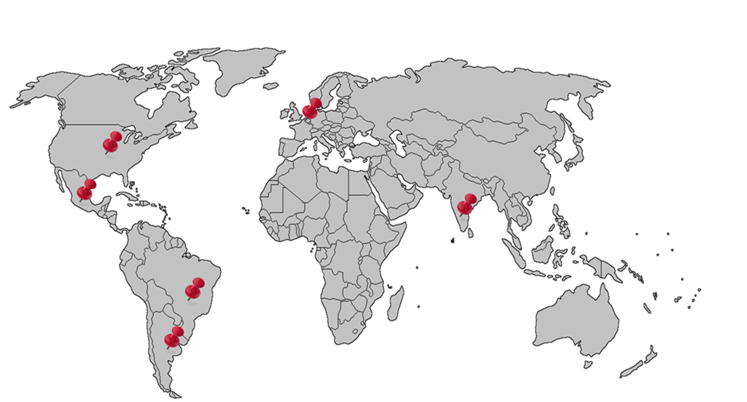
Monsanto – Global Engineering
St. Louis Global
Headquarters

Slide 4
Monsanto – Global Engineering
Businesses Supported
Crop Protection
Row Crops
Vegetables
Growth/New Technology
Technology
Corporate Services

Slide 5
Monsanto – Global Engineering
NA Row Crop Seeds Project Engineering
CAP/EX Projects $1M and under
10 Project Engineers
2 Plant Engineers
1 Project Execution Analyst
Over 30 sites supported
# of Projects | FYr
154 | 2009
279 | 2010
250 | 2011
269 | 2012
358 | 2013
500 | 2014

Slide 6
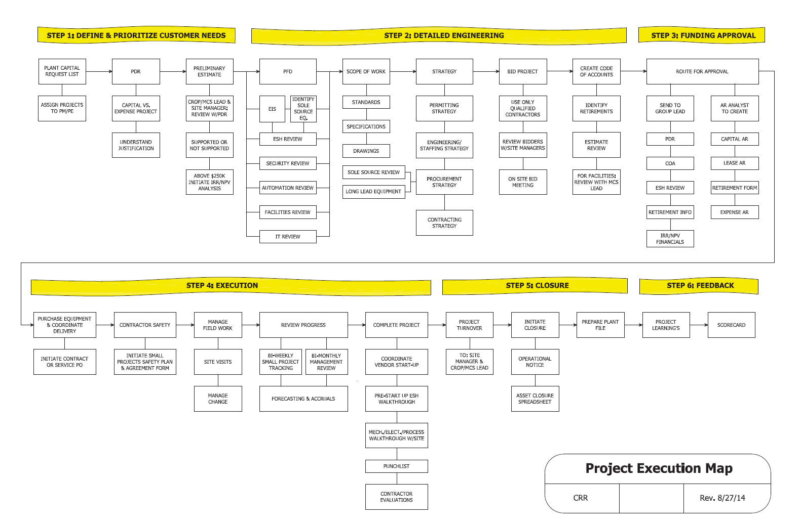
Monsanto – Global Engineering

Slide 7
Monsanto – Global Engineering

Slide 8
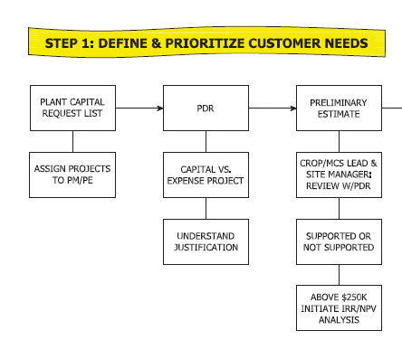
Monsanto – Global Engineering

Slide 9
Monsanto – Global Engineering
Project Execution Map Highlights
Project Prioritization
Preliminary Estimation
Streamlined Approach
Visualized Process

Slide 10
Monsanto – Global Engineering
Project Risk

Slide 11
Monsanto – Global Engineering
Non- Acceptable (Risk)
ESH
Acceptable (Risk)
*Dependent upon the situation
Cost
Timing/Logistics

Slide 12
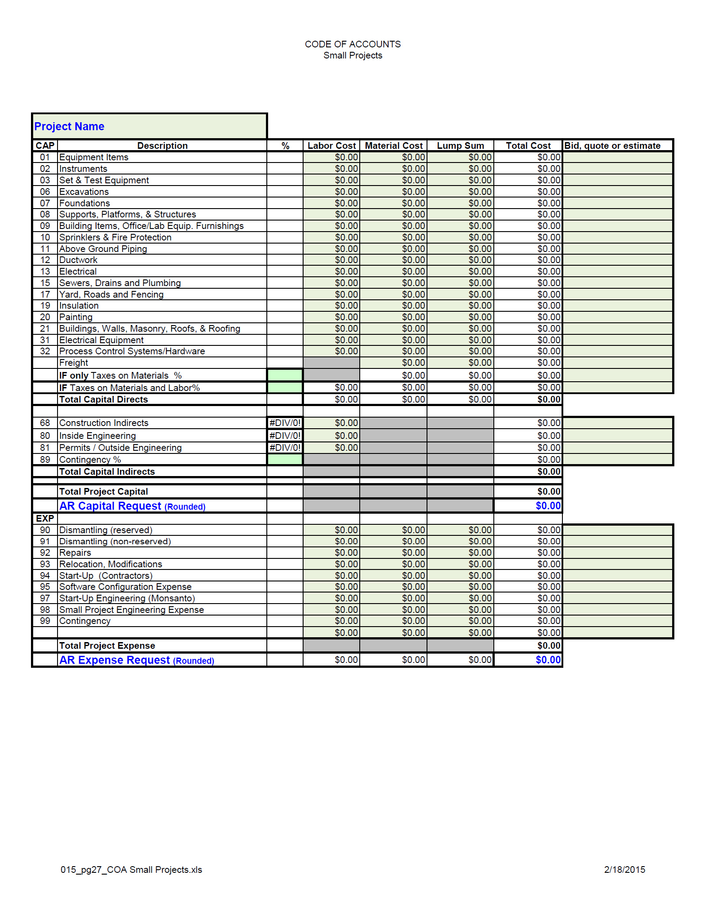
Cost
Code of Accounts
Standardized Form
Increases Accuracy
CAP/EX
Aligned with Fixed Assets

Slide 13
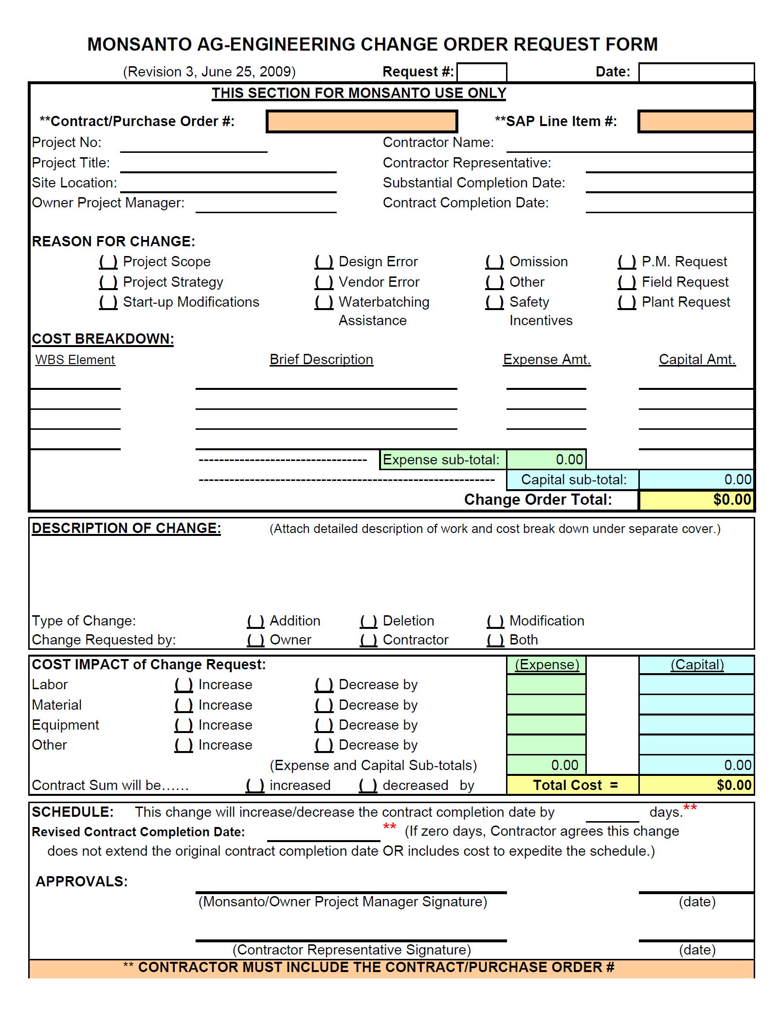
Cost
Change Orders
Simple/Structured
Time Sensitive
Both Parties Approve
PRIOR to Work Completion

Slide 14
Cost
Procurement
(10) Buyers/Cat. Managers
Quoting
PO’s
Contracts
Optimization
Partnership

Slide 15
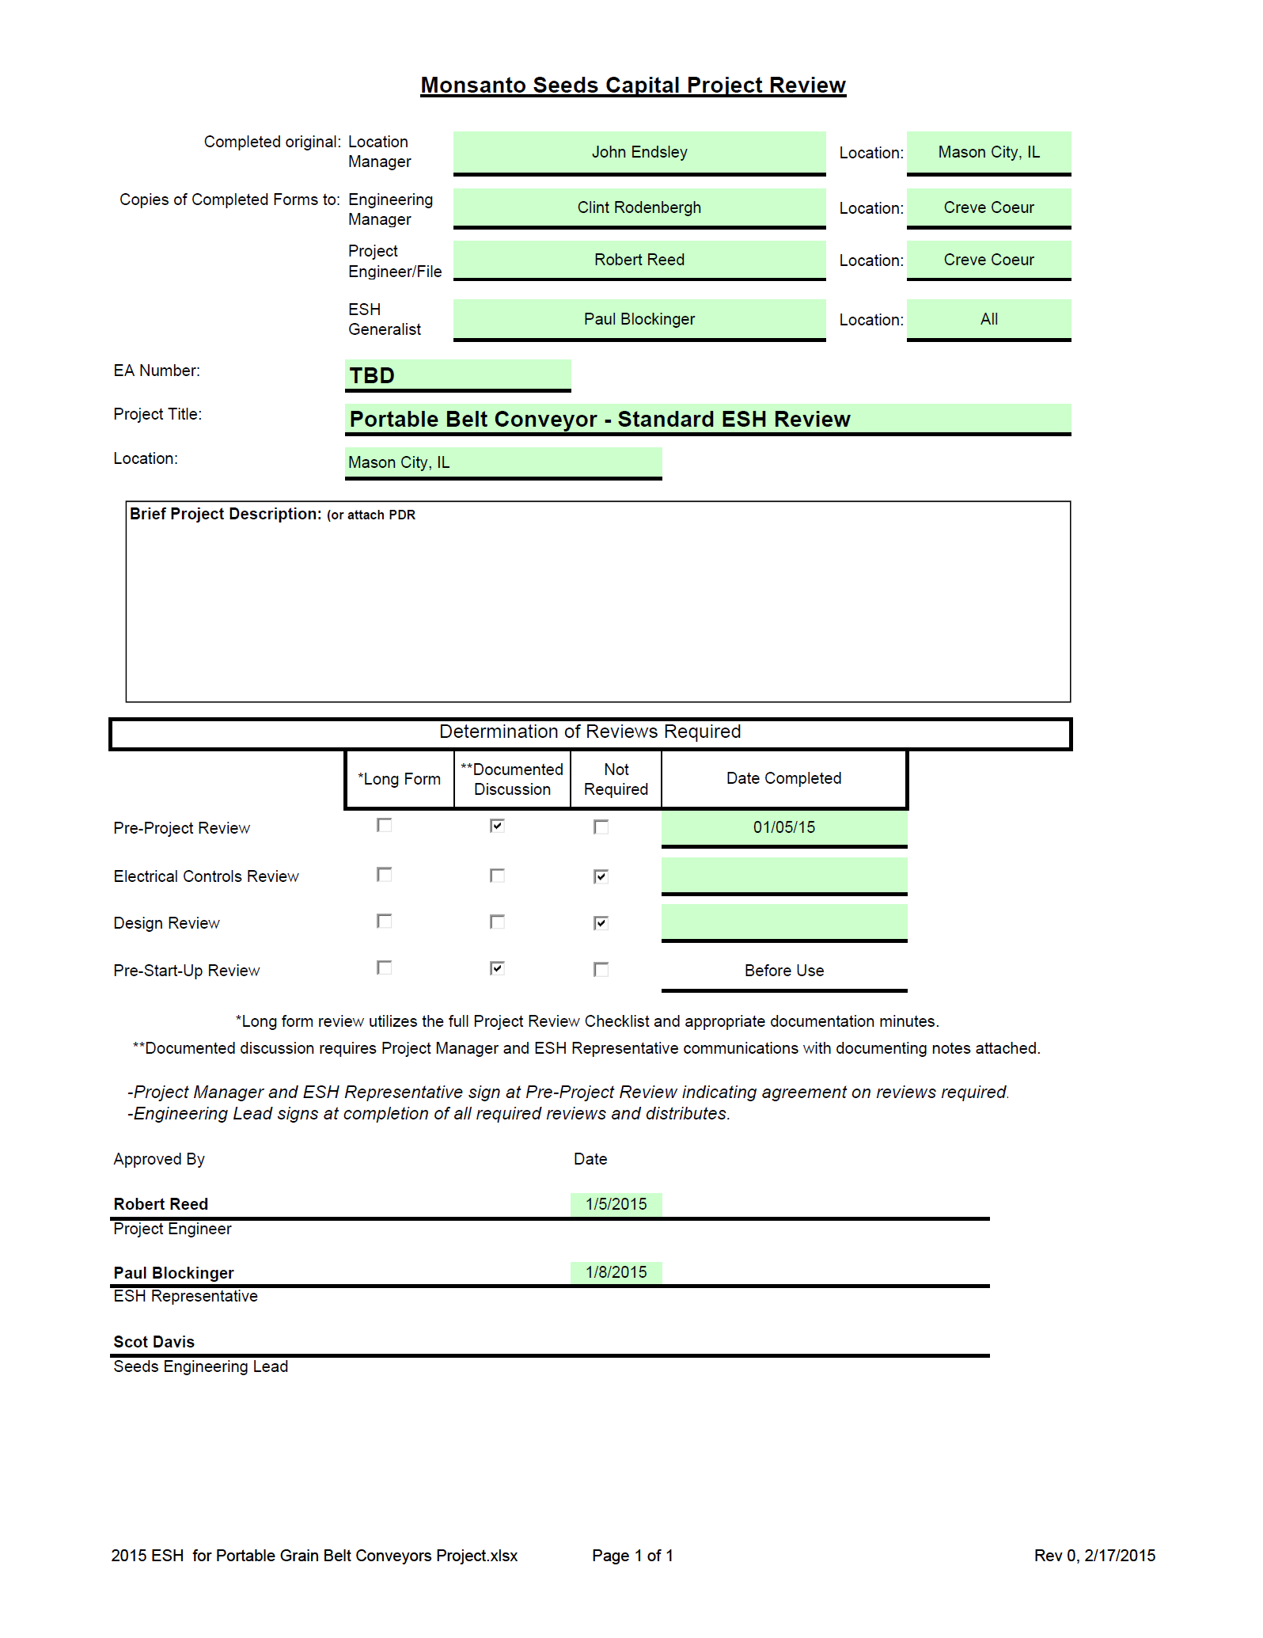
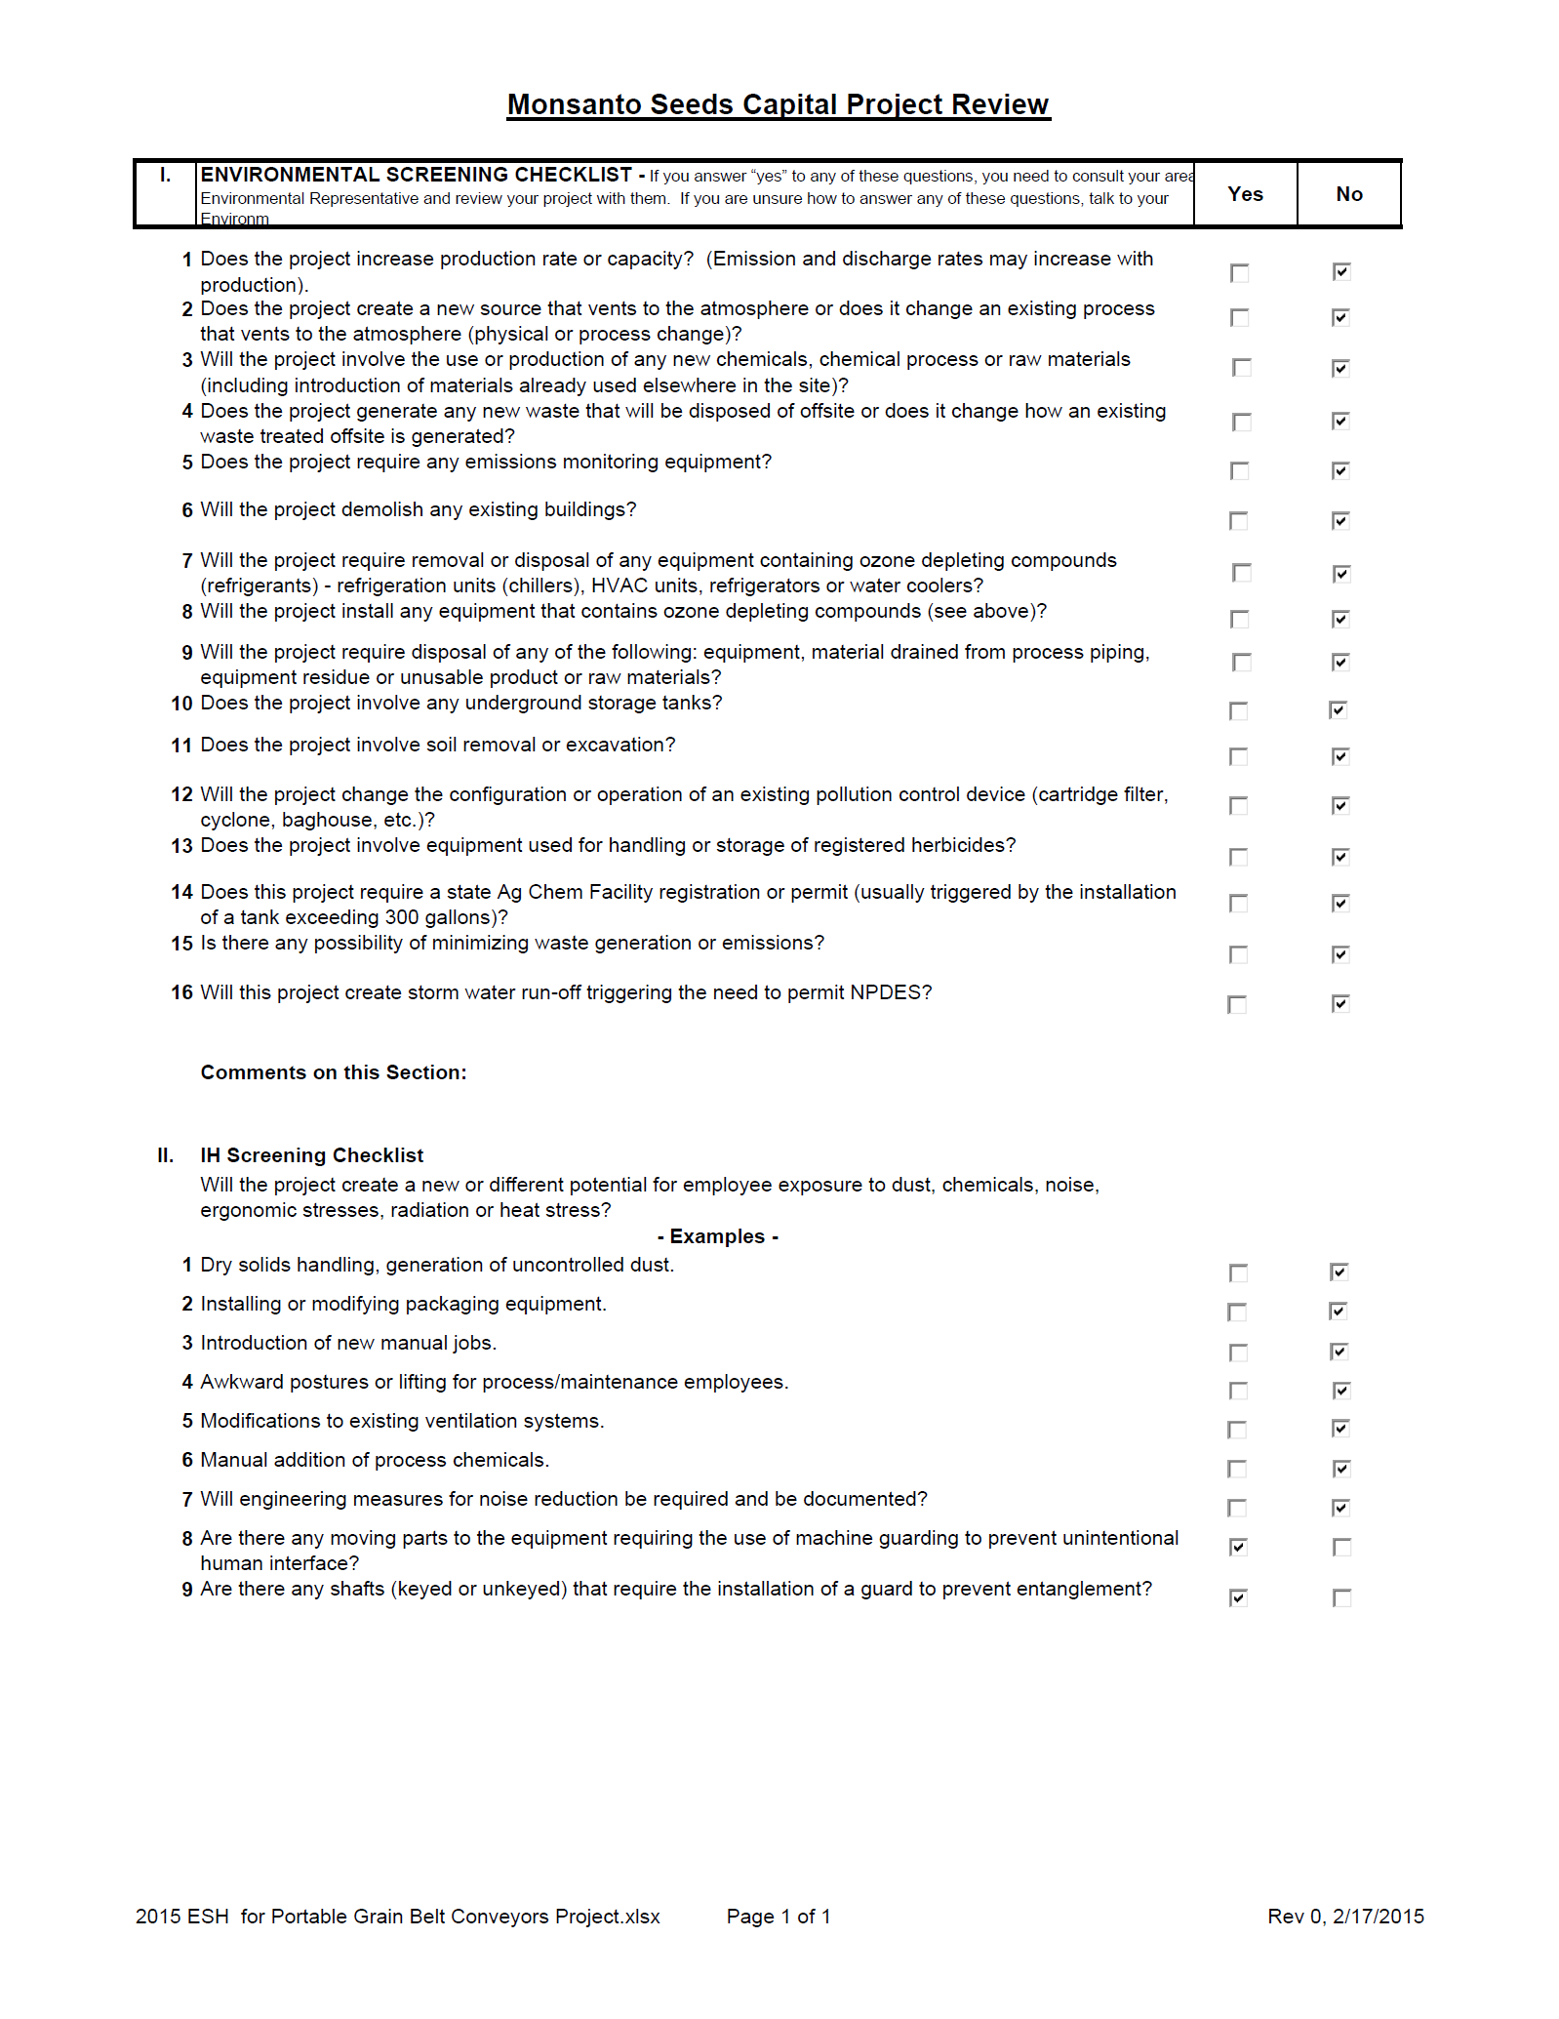
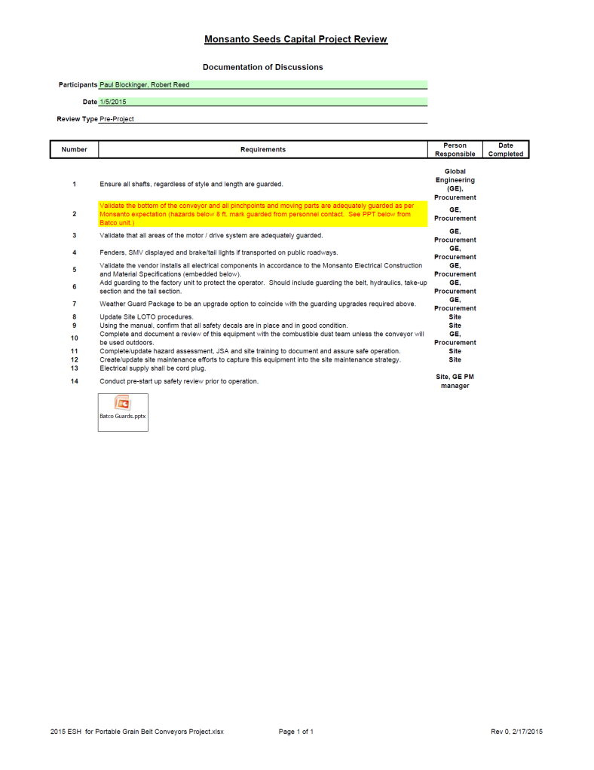
ESH – Safety
ESH Project Reviews
Prior to Routing
ID’s Additional Reviews
Structured Assesment
Assigns Responsibility

Slide 16
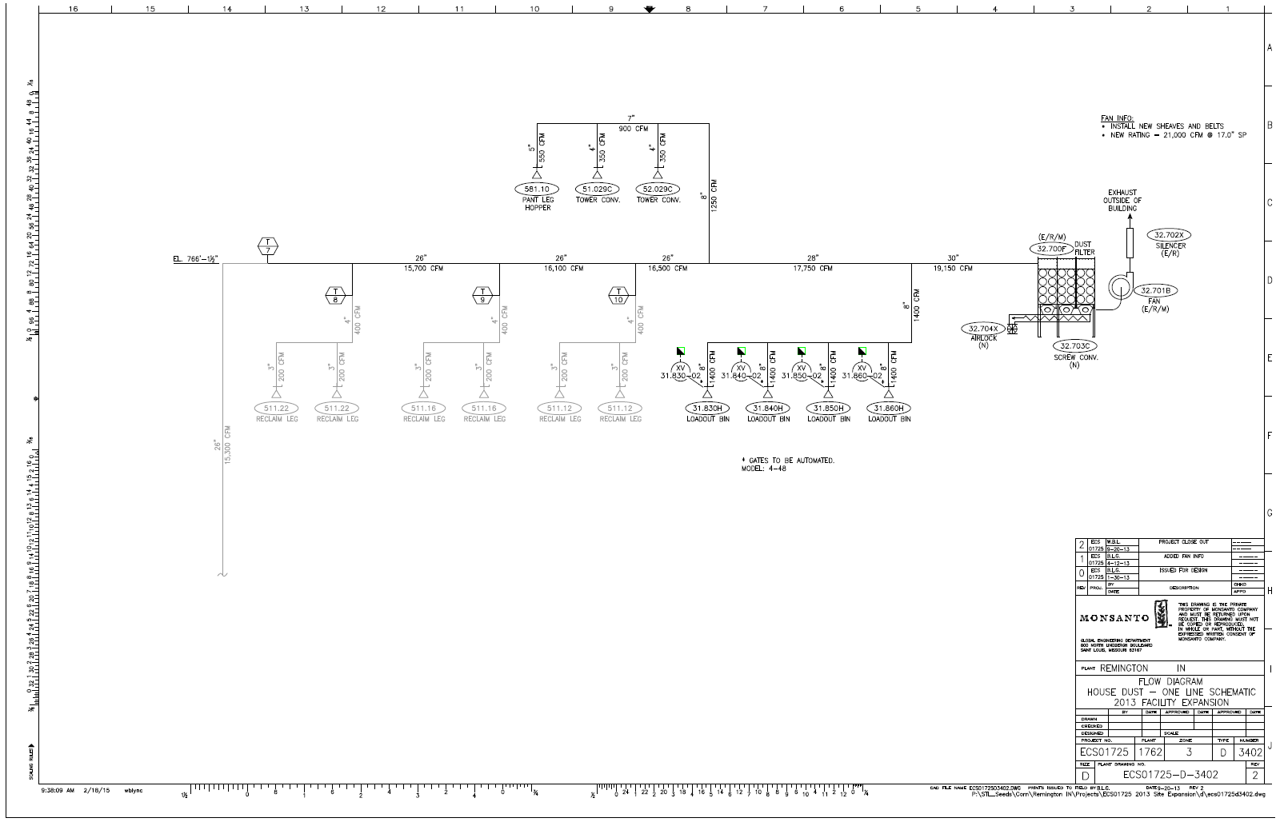
ESH – Safety
Combustible Dust Reviews
Review Scope (Pre/Design Comp./Post)
PFD (MOC)

Slide 17
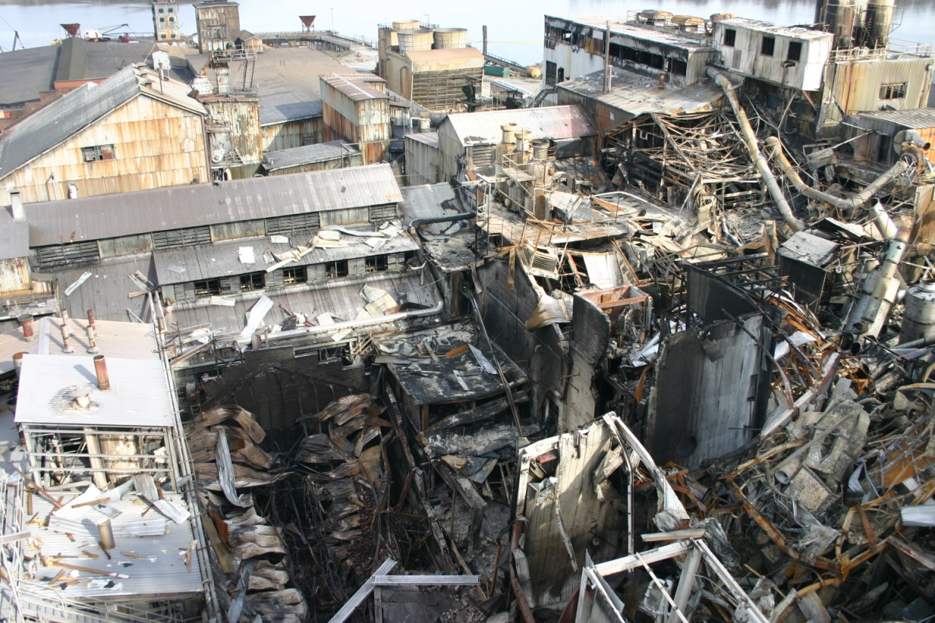
ESH - Safety
Combustible Dust Team
OSHA NEP
(3) Engineering
(2) ESH
Monthly Meetings
Notes:
14 killed 42 injured

Slide 18
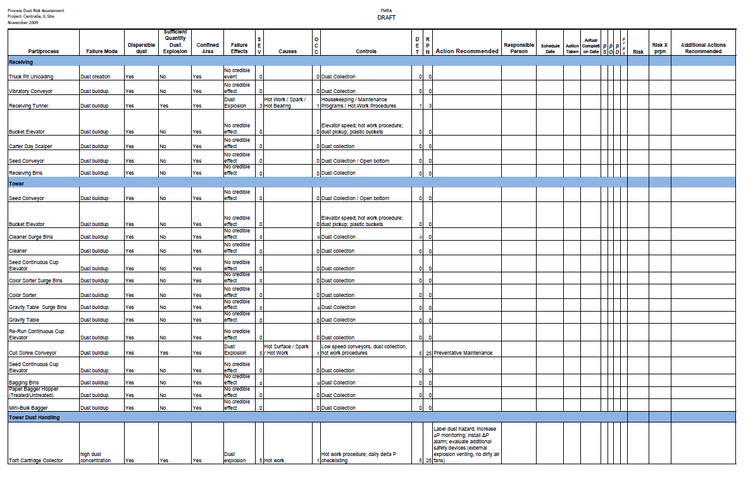
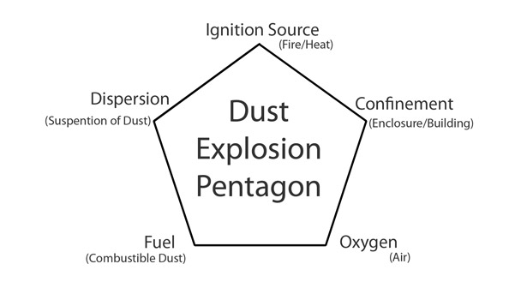
ESH – Safety
Failure Modes & Effects Analysis
New Processes/Compliance
Structured Review

Slide 19
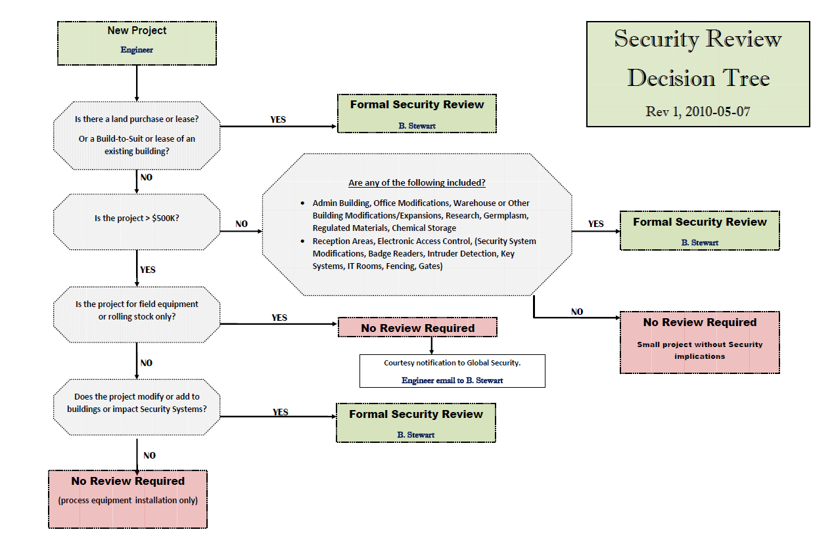
ESH – Safety
Security Review

Slide 20
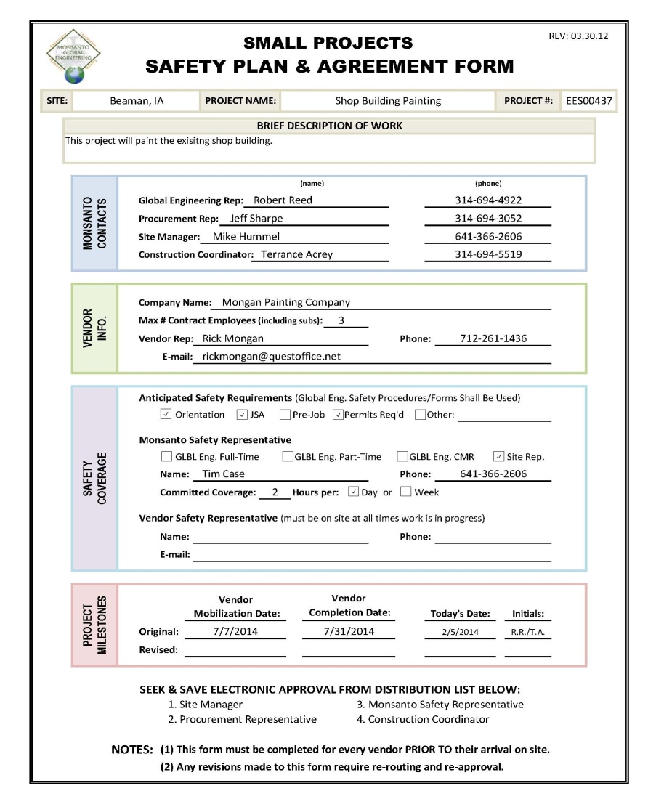
ESH – Safety
Small Project Safety Plan Agreement
Effective/Timely Comm.
Identifies Risks
Implements Safety Plan
Assigns Responsibility

Slide 21
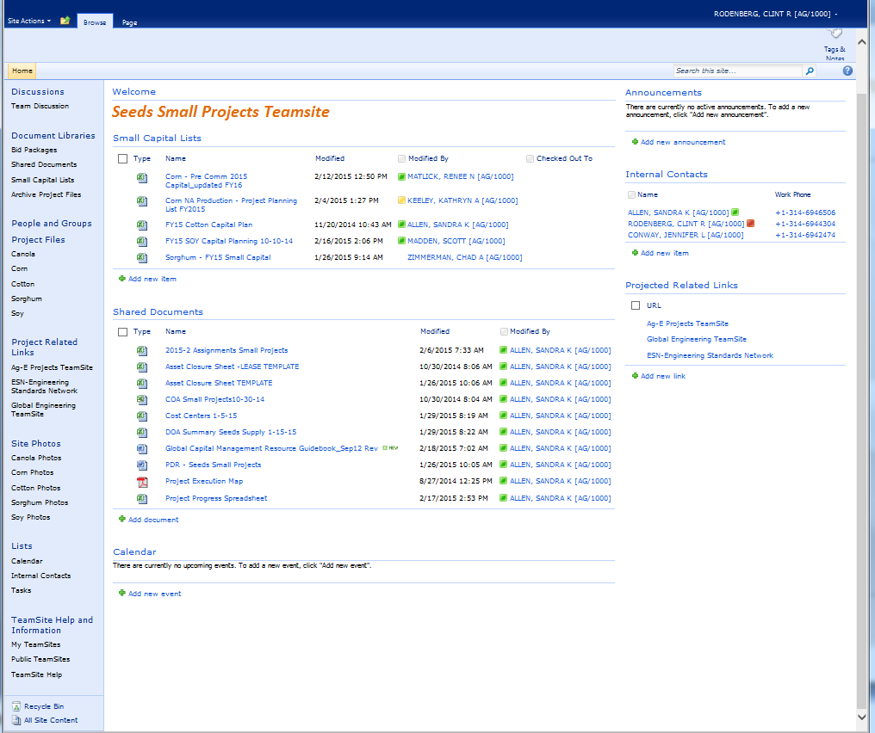
Logistics
Crop Capital Lists
Useful
Information

Slide 22
Logistics
Capital Planning Spreadsheet
Sets Project Priority (1-3)
Aligns STL with Site
Staff Planning

Slide 23
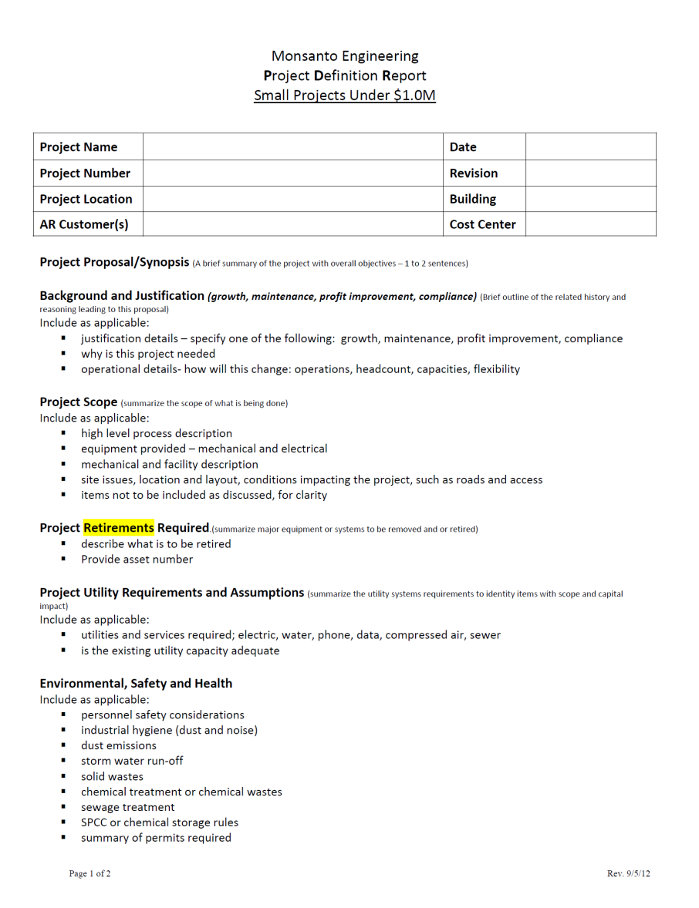
Logistics
Project Definition Report
Background/Justification
Scope
Retirements
Utilities
ESH
Strategy

Slide 24
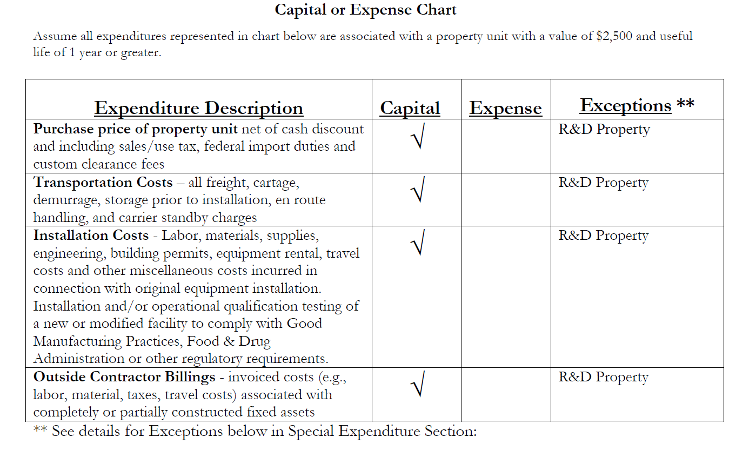
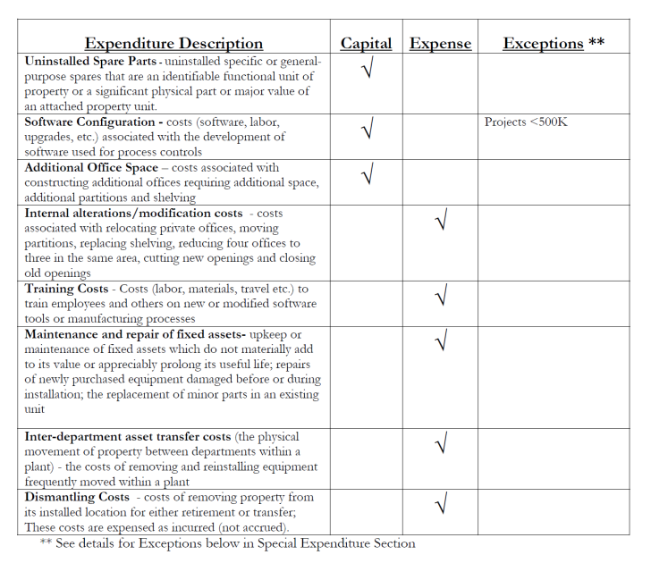
Logistics
Global Capital Management Resource Guidebook
CCP Focused
CAP/EX
Detailed Outline

Slide 25
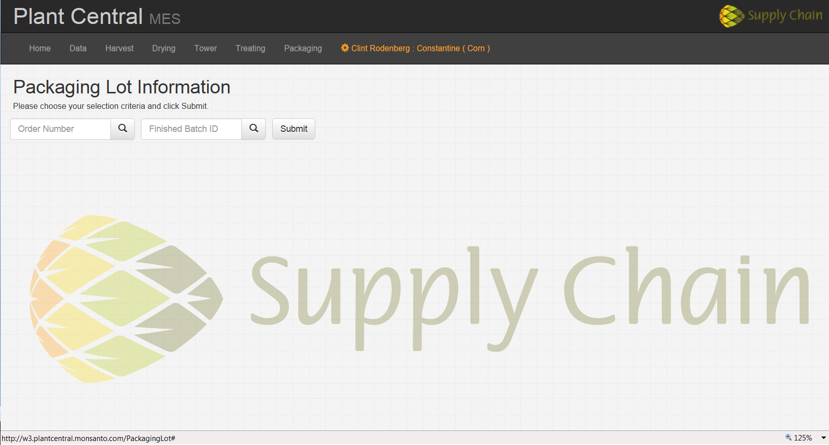
Logistics
Automation/IT Review
PM Initiates Meeting
Automation Team
IT
30+ sites

Slide 26
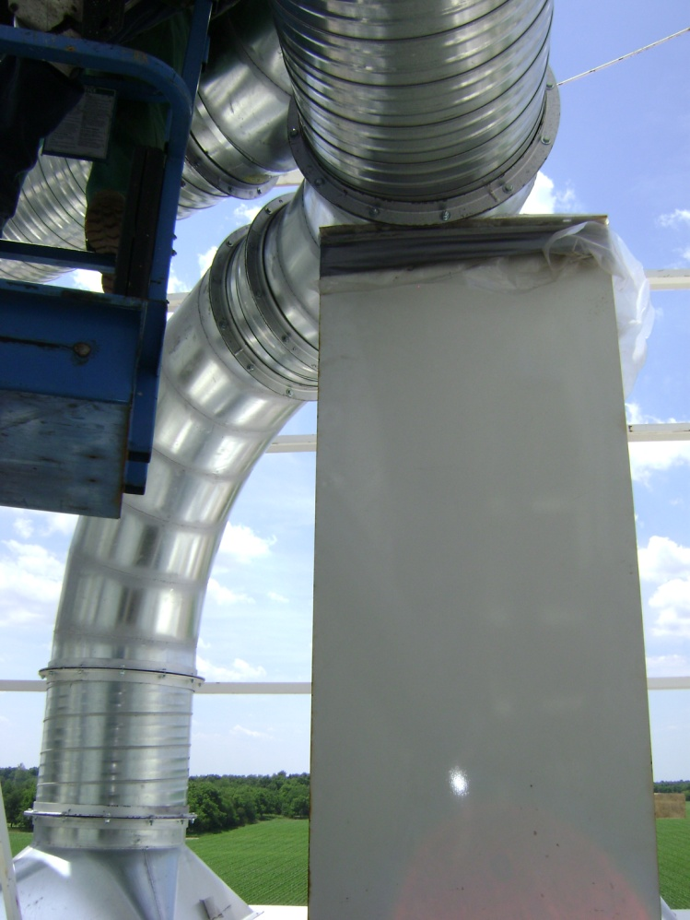
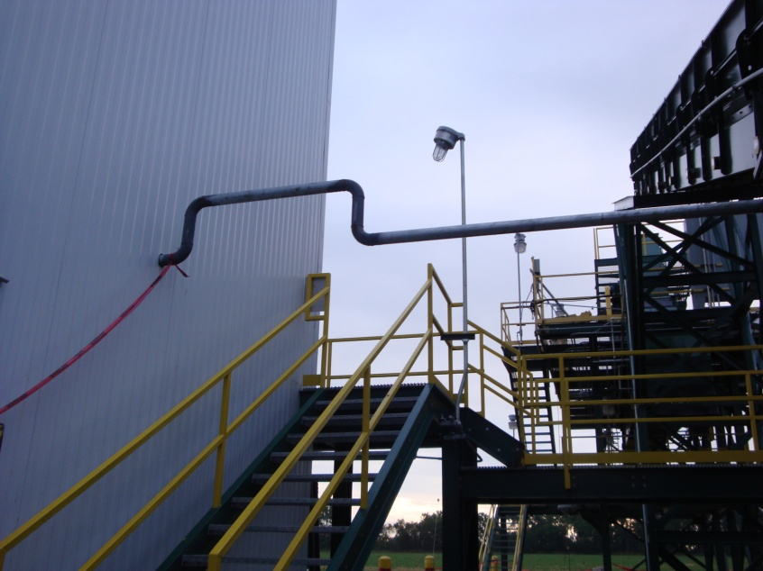
Logistics
Scopes of Work
Detailed
Special Instruction
Part of Contract

Slide 27
Logistics

Slide 28
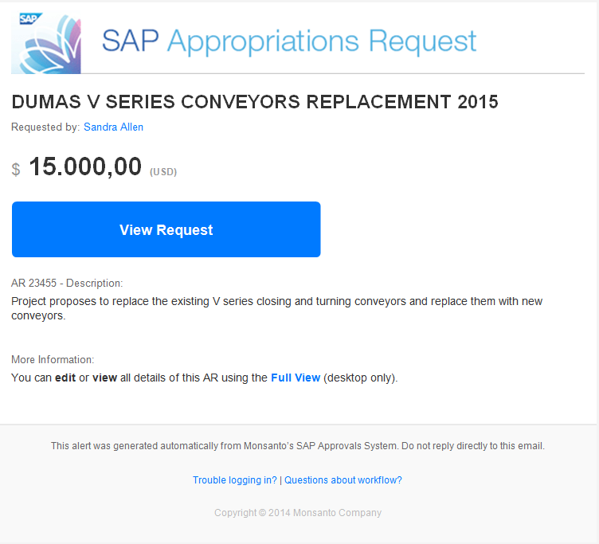
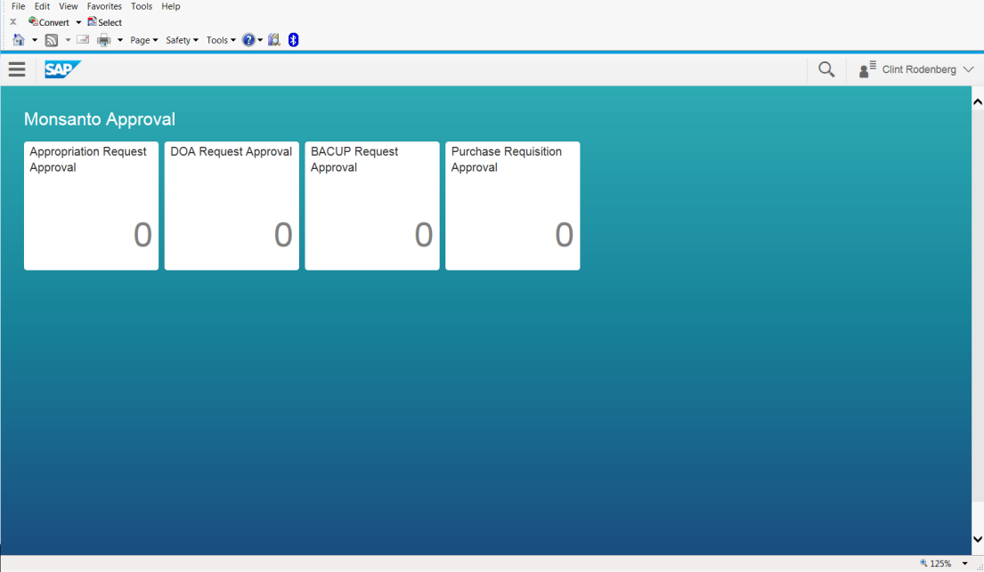
Logistics
Appropriations Request System
Appropriations Request System (SAP)
Single Source Routing/Quality Check
DOA Routing
Mobile

Slide 29
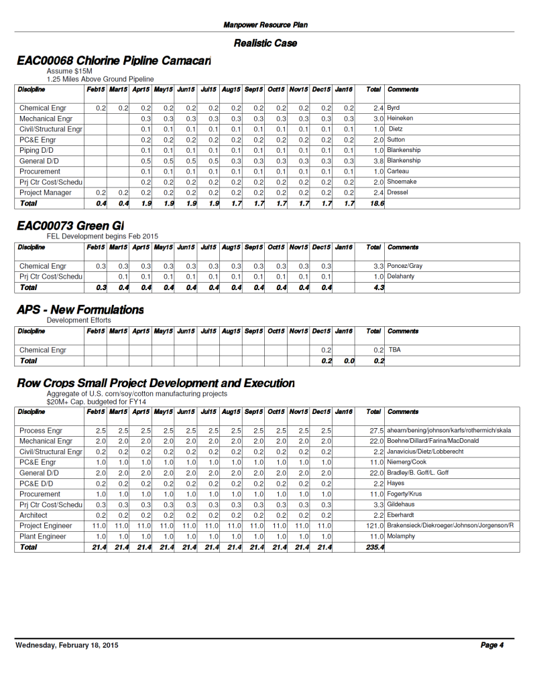
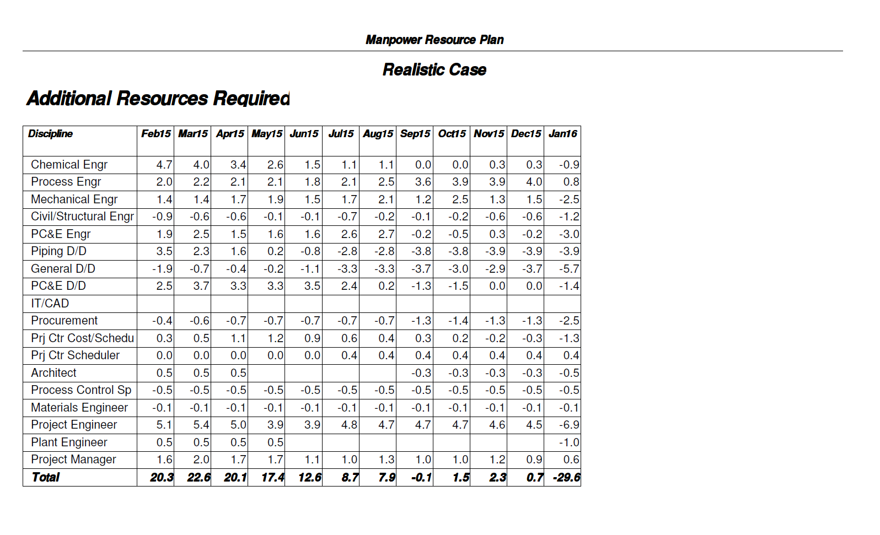
Logistics
Manpower Planning
Data Base
Monthly Alignment Meeting

Slide 30
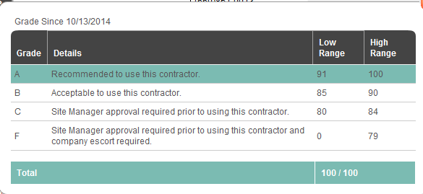
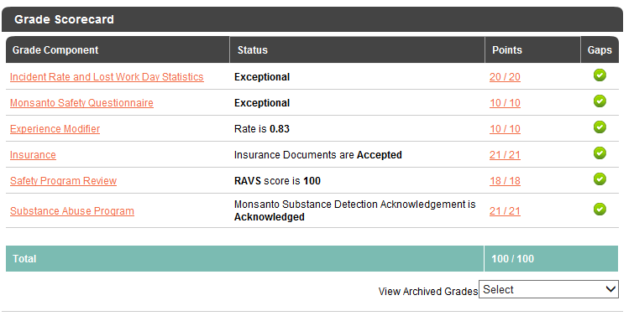
Logistics
ISNetworld
Conformance
Qualified
Reliable
Safe

Slide 31
Summary
# of Projects | FYr
154 | 2009
279 | 2010
250 | 2011
269 | 2012
358 | 2013
500 | 2014

Slide 32
Monsanto – Global Engineering
Thank YOU!
Questions??

